Slide 1
Introduction to Deep Learning
Nathaniel shimoni

Slide 2
NN intuition
Fake-estate TLV tries to estimate the true value of a house
They collect many features about houses in the imaginary area of their vacancies in TLV
We can now gather these features and use some weights per each feature and learn some function that will map from them to the price of a new house
Fake Estate
TLV

Slide 3
The building blocks
Layers
Activations
losses
Optimizers
Fully connected ANN
Number of rooms
location
3000K
Avg income in region
Area ground area
input
Hidden layers (2)
output

Slide 4
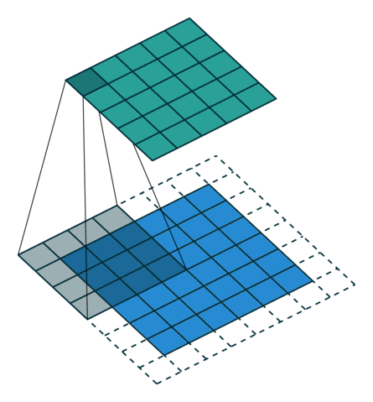
Understanding convolutions
First let’s look again at the dimensions modifications

Slide 5

The building blocks
Layers
Activations
losses
Optimizers
Convolutional Neural Network

Slide 6
layers
Our graphs are constructed of different layers with each of these layers containing one or more nodes
Fully connected layer (sometimes called Dense layer) – each of the nodes is connected to each of the following layer’s nodes
Convolutional layers – as shown in the previous slide
In the Keras library some of these layers are an abstraction of a concept like:
Input layer represents the dimensions and shape of the inputs
Reshape & Flatten layers – changes the shape of the previous layer’s output
Dropout layer – random zeroing parts of the inputs (regularization)
Batch normalization (faster convergence & regularization)

Slide 7
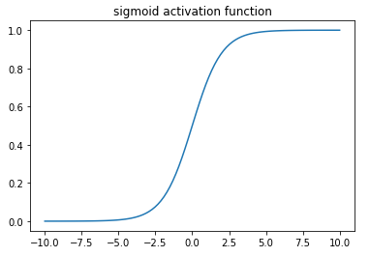
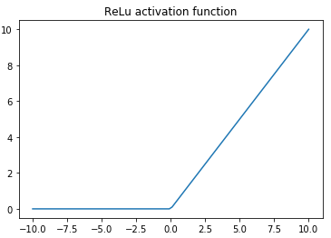
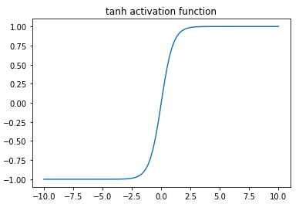
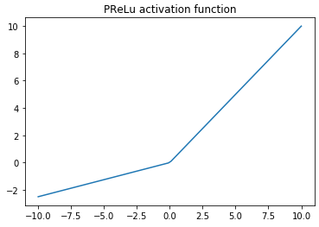
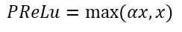
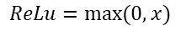
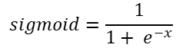
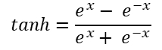
The building blocks
Sigmoid
tanh
ReLu
PReLu
Layers
Activations
losses
Optimizers
$$sigmoid=\frac{1}{1+ e^{−x}}$$
$$ReLu=max⁡(0,x)$$
$$tanh=\frac{e^{x}− e^{−x}}{e^{x}+ e^{−x}}$$
$$PReLu=max⁡(αx,x)$$

Slide 8
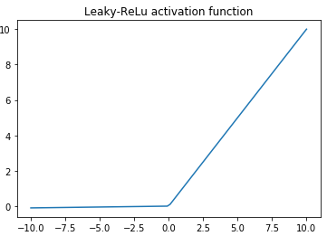
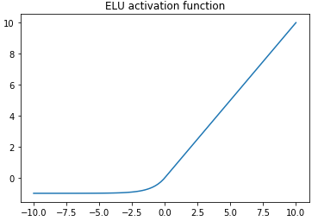
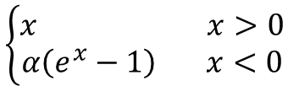
The building blocks
Leaky ReLu – a specific case of PReLu where α=0.01
ELU
Layers
Activations
losses
Optimizers
$$\left\{\begin{aligned}x x>0 \\ α\left(e^{x}−1\right) x<0\end{aligned}\right.$$

Slide 9
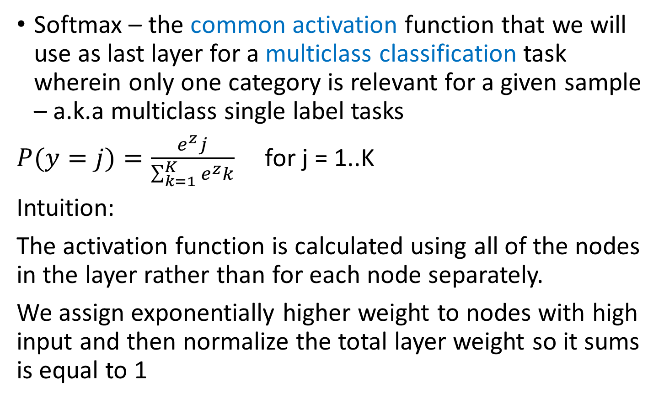
The building blocks
Softmax – the common activation function that we will use as last layer for a multiclass classification task wherein only one category is relevant for a given sample – a.k.a multiclass single label tasks
$P(y=j)=\frac{e^{z}j}{\sum_{k=1}^{K}{e^{z}k}}$ for j = 1..K
Intuition:
The activation function is calculated using all of the nodes in the layer rather than for each node separately.
We assign exponentially higher weight to nodes with high input and then normalize the total layer weight so it sums is equal to 1
Layers
Activations
losses
Optimizers

Slide 10
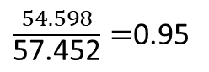
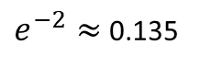
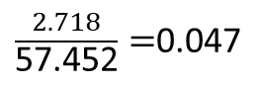
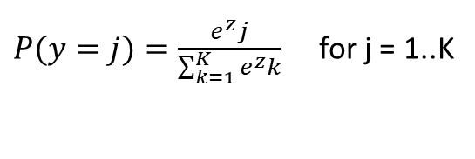
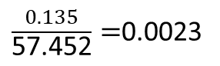
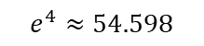
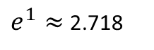
The building blocks
Softmax (cont.)
Number of nodes is equal to number of categories
Lets explore an example for 3 categories:
Layers
Activations
losses
Optimizers
Input=-2
Input=1
Input=4
$e^{−2}≈$0.135
$e^{1}≈$ 2.718
$P(y=j)=\frac{e^{z}j}{\sum_{k=1}^{K}{e^{z}k}}$ for j = 1..K
$$e^{4}≈54.598$$
$\frac{0.135}{\text{57.452}}=$0.0023
$\frac{2.718}{\text{57.452}}=$0.047
$\frac{54.598}{\text{57.452}}=$0.95
0.135 + 2.718 + 54.598 = 57.452
Softmax assigns a high probability to the maximal input and exponentially lower probability to other inputs respectively
s.t. sum of all outputs should equal to 1

Slide 11

The building blocks
Layers
Activations
losses
Optimizers
For a regression problem we will usually use either linear activation or ReLU activation for our last model layer
Another way to handle regression tasks is to use “label normalization” and sigmoid / tanh and an activation for the last layer of our model
Example:
An airline wants to predict how many passengers will a future flight have…
We can predict:
the # of passengers
Or
predict % of the full airline capacity

Slide 12
The building blocks
A loss function is a function that will take our graph outputs, compare them with the ground-truth and generate an indicator of how good is our model at achieving its goal
Common loss functions include: Regression Mean-squared-error (MSE) Mean-absolute-error (MAE) Mean-squared-logarithmic-error (MSLE) mean-absolute-percentage-error (MAPE)
Classification logistic loss (binary cross-entropy) categorical cross-entropy
Layers
Activations
losses
Optimizers

Slide 13
The building blocks
Not all classification tasks are single label tasks
Some categorical tasks can involve multiple labels per sample (i.e. indicating many characteristics of an object where each object can have some of them)
Problems of this type are defined as ”multi-label classification tasks”
To allow multiple output nodes’ predictions to be equal to 1 (or close to 1) we will use the sigmoid activation function for the last layer in our model graph
Note that since this will be the last layer of the network vanishing gradients phenomena is less likely to dominate our learning process
We will also use binary cross-entropy as a loss function
Layers
Activations
losses
Optimizers

Slide 14
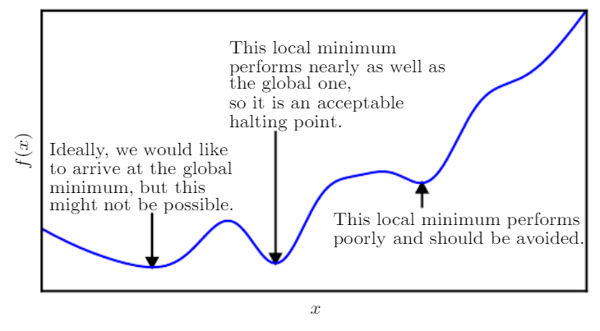
The building blocks
Gradient Decent
Stochastic Gradient Decent
RMSprop
Adagrad
Adadelta
Adam
Nadam
Cyclic learning rate
One cycle method
Layers
Activations
losses
Optimizers
Source: www.deeplearningbook.org

Slide 15
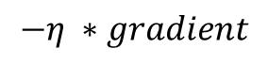
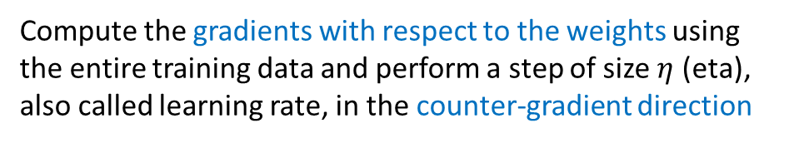
optimizers
Gradient Decent
Stochastic Gradient Decent
RMSprop
Adagrad
Adadelta
Adam
Nadam
Cyclic learning rate
One cycle method
Compute the gradients with respect to the weights using the entire training data and perform a step of size $η$ (eta), also called learning rate, in the counter-gradient direction
$$−η ∗gradient$$

Slide 16
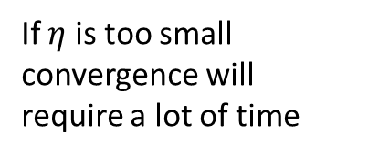
optimizers
Gradient Decent
Stochastic Gradient Decent
RMSprop
Adagrad
Adadelta
Adam
Nadam
Cyclic learning rate
One cycle method
Compute the gradients with respect to the weights using the entire training data and perform a step of size $η$ (eta), also called learning rate, in the counter-gradient direction
If $η$ is too small convergence will require a lot of time

Slide 17
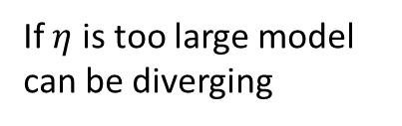
optimizers
Gradient Decent
Stochastic Gradient Decent
RMSprop
Adagrad
Adadelta
Adam
Nadam
Cyclic learning rate
One cycle method
Compute the gradients with respect to the weights using the entire training data and perform a step of size $η$ (eta), also called learning rate, in the counter-gradient direction
If $η$ is too large model can be diverging

Slide 18
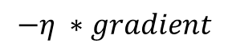
optimizers
Gradient Decent
Stochastic Gradient Decent
RMSprop
Adagrad
Adadelta
Adam
Nadam
Cyclic learning rate
One cycle method
Compute the gradients with respect to the weights using a subset of training data and perform a step of size, in the counter-gradient direction this accelerates the learning process and also helps avoiding convergence to a local minimum (as each batch may have different gradients)
$$−η ∗gradient$$

Slide 19
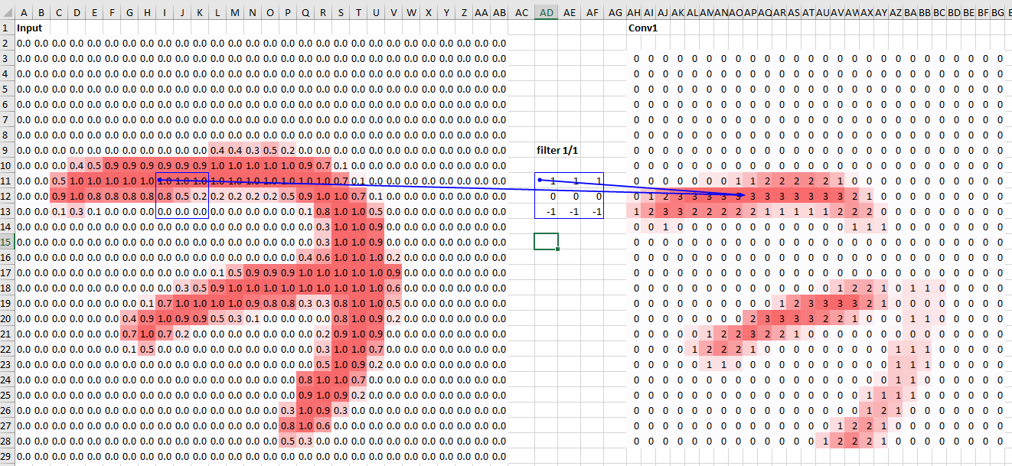
Understanding convolutions
Taken from content on fast.ai course notebooks

Slide 20
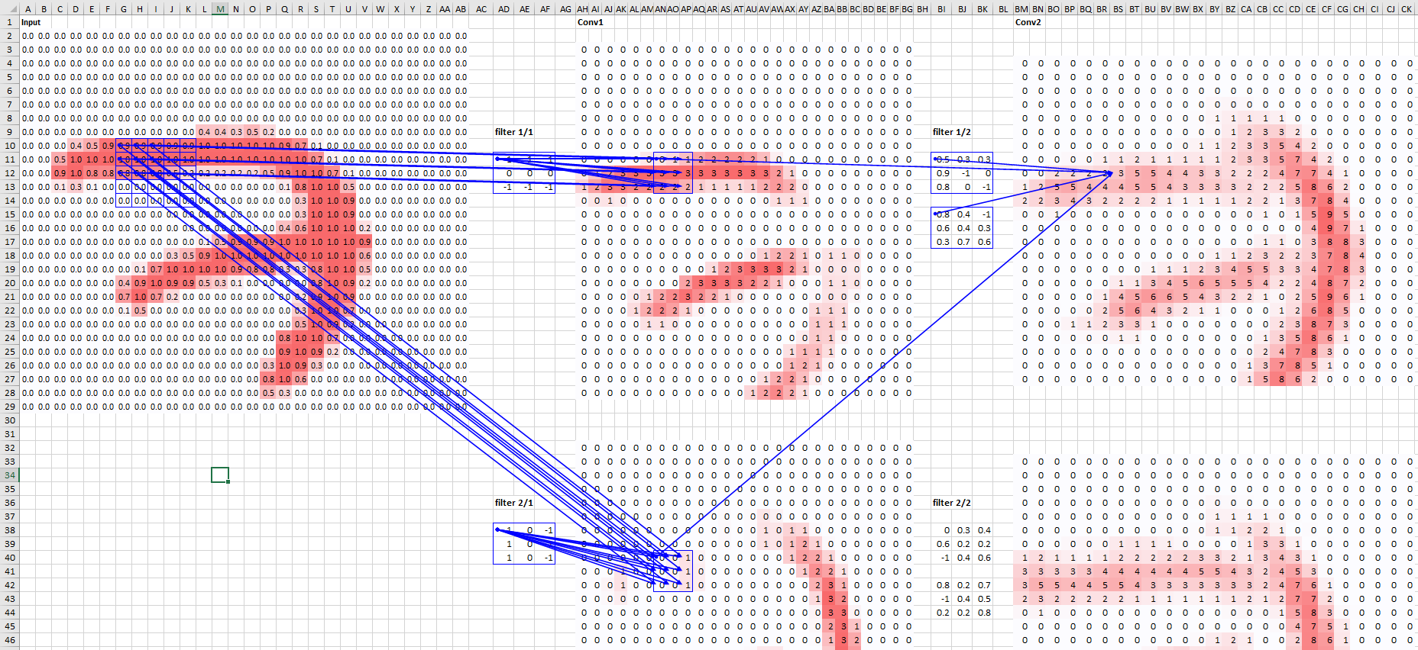
Understanding convolutions
Understanding the concept of receptive field
Taken from content on fast.ai course notebooks

Slide 21
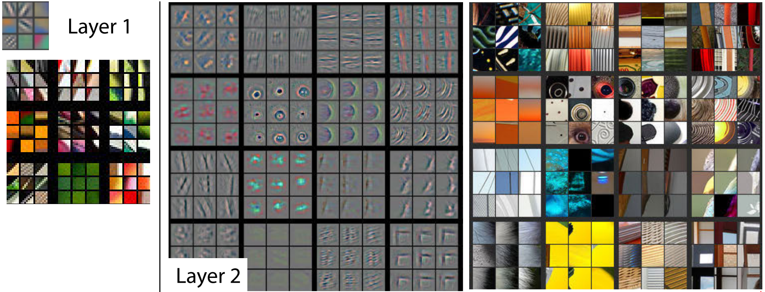
Understanding convolutions
Visualizing and Understanding Convolutional Networks - Matthew D. Zeiler

Slide 22
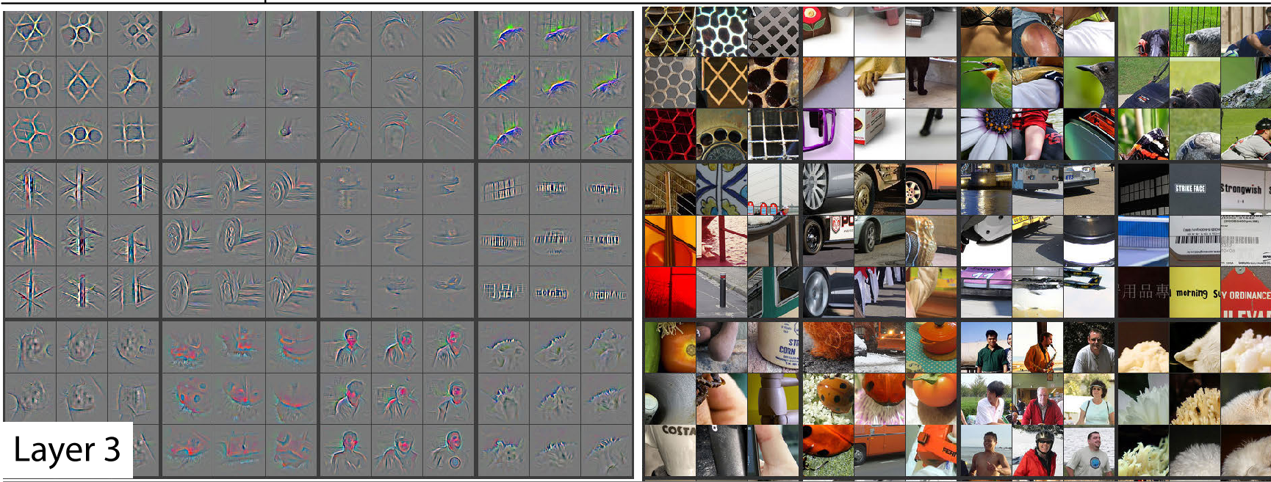
Understanding convolutions
Visualizing and Understanding Convolutional Networks - Matthew D. Zeiler

Slide 23
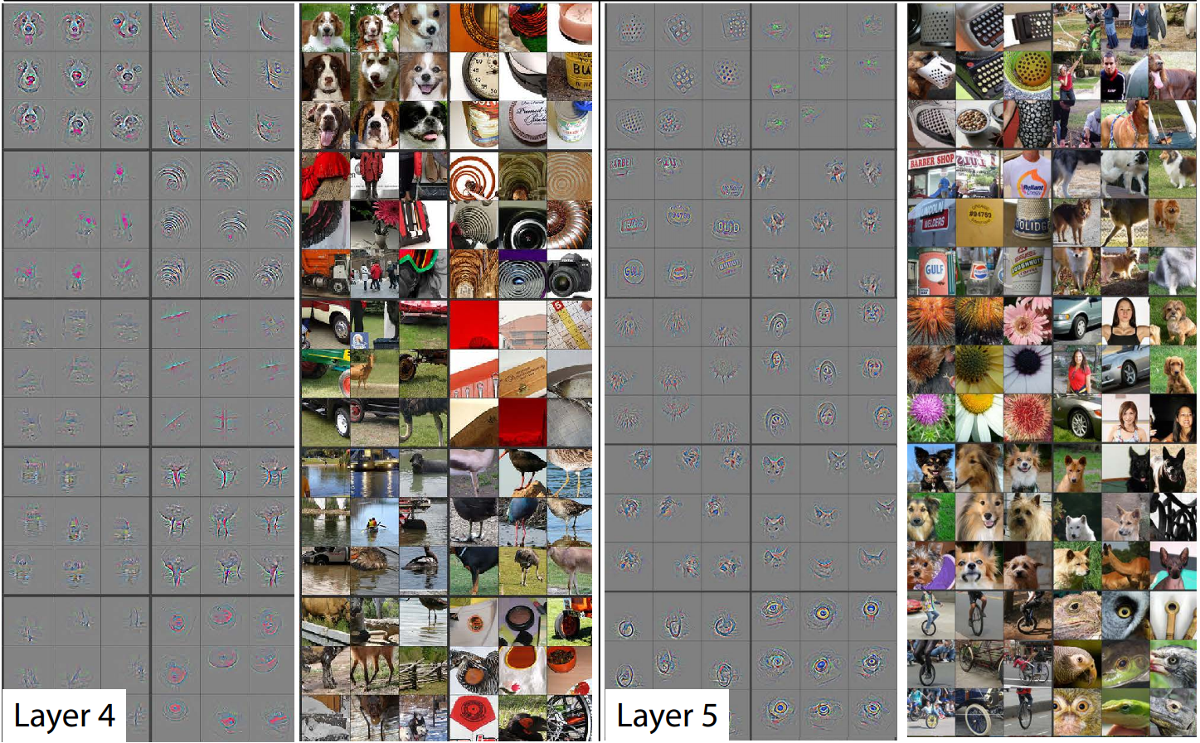
Understanding convolutions
Visualizing and Understanding Convolutional Networks - Matthew D. Zeiler

Slide 24
The building blocks – cont. from last lesson
Gradient Decent
Stochastic Gradient Decent
RMSprop
Adagrad
Adadelta
Adam
Nadam
Cyclic learning rate
One cycle method
Layers
Activations
losses
Optimizers
Source: www.deeplearningbook.org

Slide 25
optimizers
Gradient Decent
Stochastic Gradient Decent
RMSprop
Adagrad
Adadelta
Adam
Nadam
Cyclic learning rate
One cycle method
Compute the gradients with respect to the weights using the entire training data and perform a step of size $η$ (eta), also called learning rate, in the counter-gradient direction
$$−η ∗gradient$$

Slide 26
optimizers
Gradient Decent
Stochastic Gradient Decent
RMSprop
Adagrad
Adadelta
Adam
Nadam
Cyclic learning rate
One cycle method
Compute the gradients with respect to the weights using the entire training data and perform a step of size $η$ (eta), also called learning rate, in the counter-gradient direction
If $η$ is too small convergence will require a lot of time

Slide 27
optimizers
Gradient Decent
Stochastic Gradient Decent
RMSprop
Adagrad
Adadelta
Adam
Nadam
Cyclic learning rate
One cycle method
Compute the gradients with respect to the weights using the entire training data and perform a step of size $η$ (eta), also called learning rate, in the counter-gradient direction
If $η$ is too large model can be diverging

Slide 28
optimizers
Gradient Decent
Stochastic Gradient Decent
RMSprop
Adagrad
Adadelta
Adam
Nadam
Cyclic learning rate
One cycle method
Compute the gradients with respect to the weights using a subset of training data and perform a step of size, in the counter-gradient direction this accelerates the learning process and also helps avoiding convergence to a local minimum (as each batch may have different gradients)
$$−η ∗gradient$$

Slide 29
Optimizers
Gradient Decent yield good results with convex functions but for non convex loss functions it has high probability to “get stuck” in a local minimum

Slide 30
Optimizers
One solution to this problem is using momentum
We can think of momentum as the rolling ball acceleration – mathematically we add the decaying average of previous gradients to our current gradient
This allows us to avoid to causes of local minimum convergence:
Plateau with zero gradients and no more updates
Oscillations caused by opposite gradients

Slide 31
Optimizers
Another solution to this problem is by making
adjustments to the learning rate that we are using:
Adagrad – adaptive learning rate per weight, learning rate is divided by ${(\sum{{all prev. grad}^{2})}}^{\frac{1}{2}}/n$
Adadelta - adaptive learning rate per weight, learning rate is divided by ${(\sum{{fixed wind of prev. grad}^{2})}}^{\frac{1}{2}}/n$
RMSProp - adaptive learning rate per weight, learning rate is divided by ${(\sum{{\exp{decaying}prev. grad}^{2})}}^{\frac{1}{2}}/n$
adam – RMSProp + momentum
A great explanation of these and many more is available on: http://ruder.io/optimizing-gradient-descent/index.html#nesterovacceleratedgradient

Slide 32
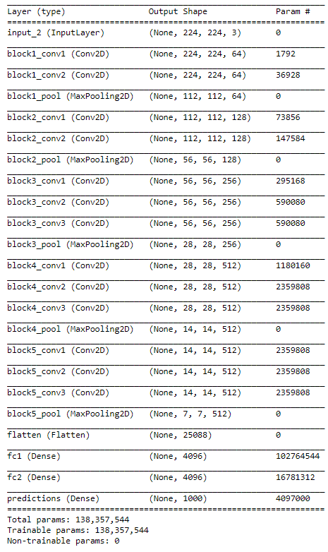

VGG 16 architecture
2 x conv 1 pool block
3 x conv 1 pool block
Flatten + fully connected block

Slide 33
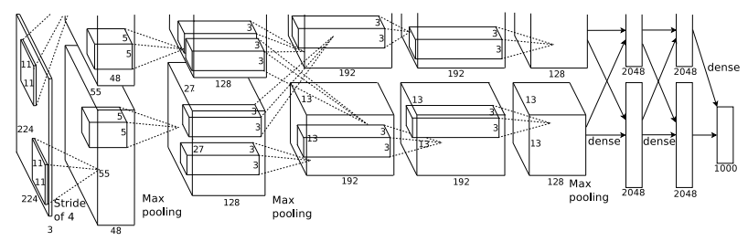
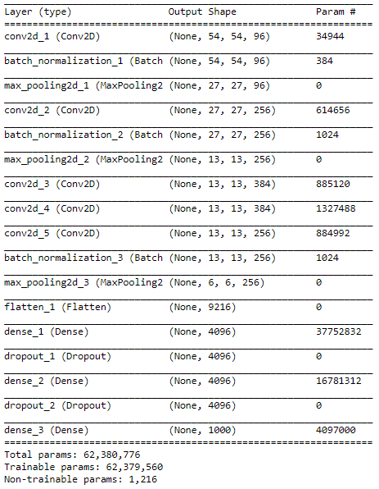
AlexNet architecture
AlexNet
Conv + BN + Pooling block
Conv only block
[Flatten +] fully connected block

Slide 34
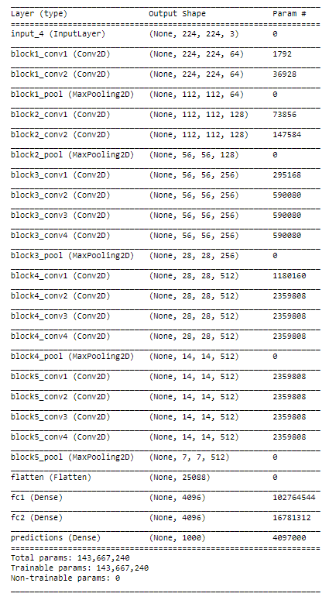
VGG 16/19 architecture
VGG16
2 x conv 1 pool block
3 x conv 1 pool block
Flatten + fully connected block
VGG19
2 x conv 1 pool block
4 x conv 1 pool block
Flatten + fully connected block

Slide 35
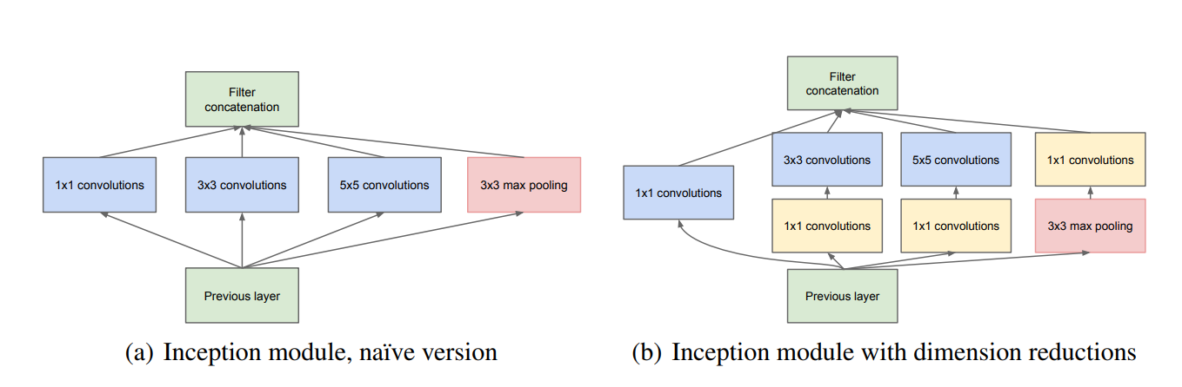
Inception / GoogLeNet
In an Inception block there are many (1x1) convolutions
that are aimed at decreasing the number of computations performed along with padding to allow concatenation in the channels dimension
Inception basic blocks with and without dimensions reduction
https://arxiv.org/pdf/1409.4842.pdf inception original paper

Slide 36
Inception block example
32x32x128
output
input
Conv2d(128, (1x1))
32x32x672
32x32x256
32x32x96
32x32x96
Conv2d(96, (5x5))
32x32x192
Conv2d(192, (3x3))
32x32x256
MaxPool 3x3

Slide 37
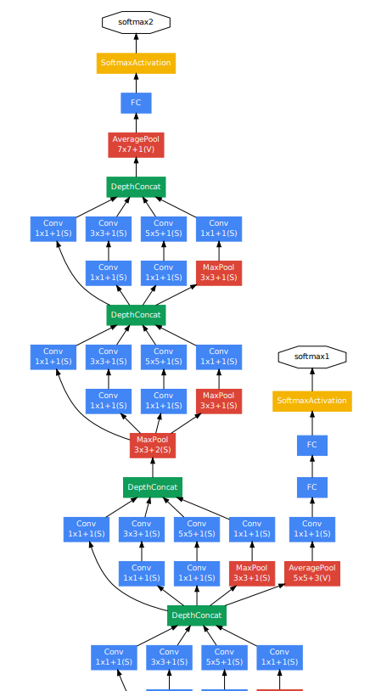
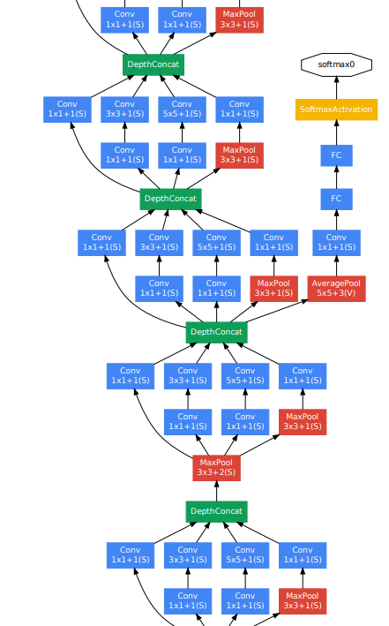
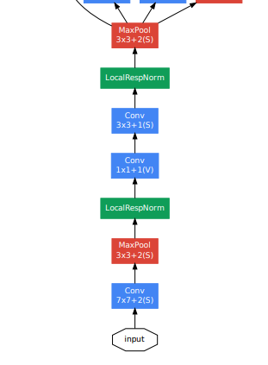
Inception architecture

Slide 38
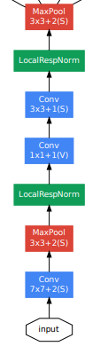
Inception architecture
Input basic network

Slide 39
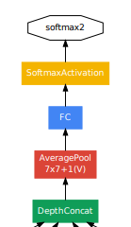
Inception architecture
Note that the output network is with a single FC layer

Slide 40
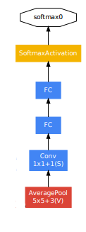
Inception architecture
Two additional output paths to help earlier blocks converge

Slide 41
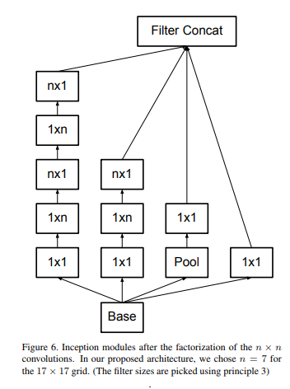
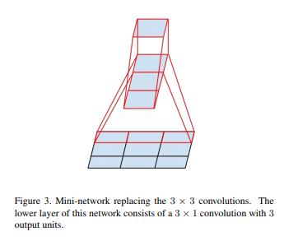
Inception v3
Inception V3 introduced a wider basic block
And also inserted flattened convolutions (1xn, nx1)
This allowed for a significant decrease in the number of trained weights,
enabling the training of much deeper networks with better generalization
We can have 5+5 computations per channel and still represent most of the signal in the data
Instead of having 5x5 computations per channel
Vertical flattened convolution followed by horizontal flattened convolution
https://arxiv.org/pdf/1512.00567.pdf - inception v3 paper

Slide 42
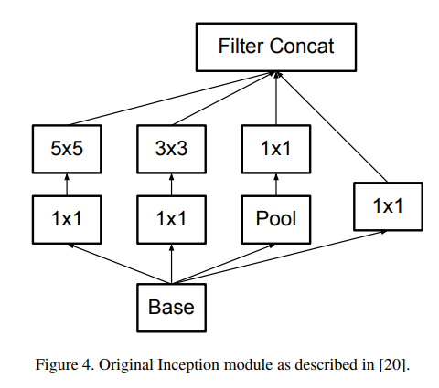
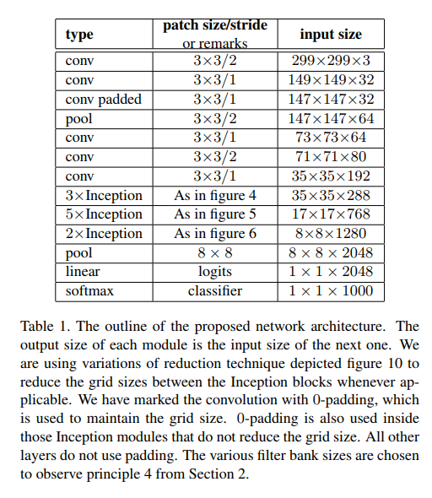
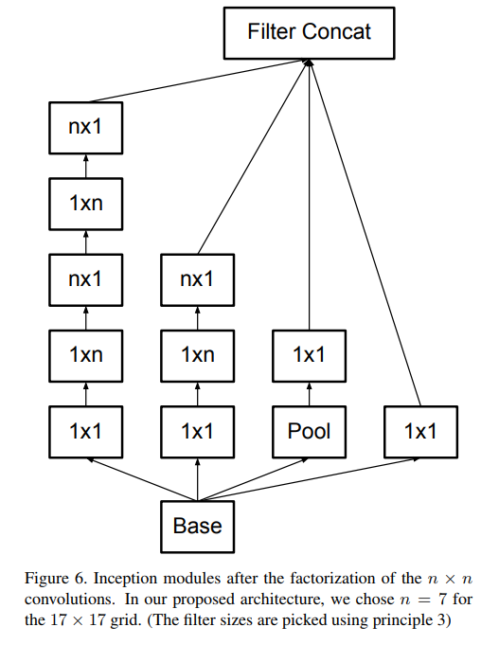
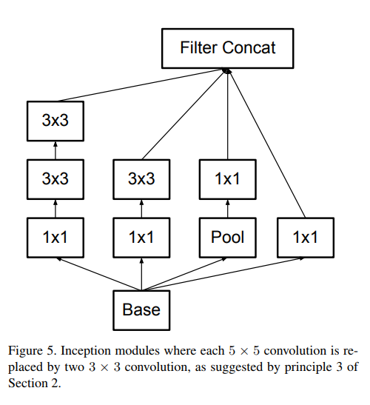
Inception v3

Slide 43
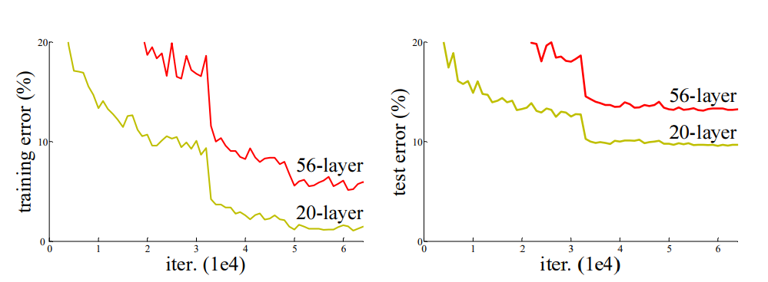
ResNet – can’t we just go deeper & deeper
Notice 2 phenomena:
Test error significantly higher than training, but also…
Training error for 56-layer network is higher than that of 20 layer net!

Slide 44
ResNet – can’t we just go deeper & deeper
Basic idea:
This is not an overfitting problem but rather an optimization problem.
Hypothesis: Instead of having each layer learn a new mapping, optimization would be easier if each layer (or block) would have to learn the residual error of the previous layers
In other words – if 20 layers is easier to optimize allow for the rest of the layers to easily converge to 0 unless they lead to a better result.

Slide 45
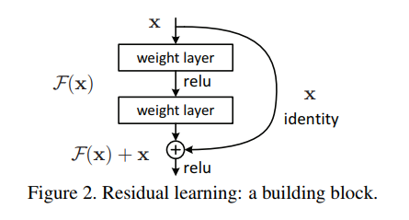

ResNet – revolution of depth
Let $ℱ\left(x\right)$ be the feature mapping of the regularly stacked layers
Each residual block is then trying to optimize $H\left(x\right)= ℱ\left(x\right)+x$
If $ℱ\left(x\right)$ does not improve the loss of $H\left(x\right)$ relatively to the loss of identity $x$,
then $ℱ\left(x\right)$ will be set to zero or very close to it
This somewhat resembles the idea of boosting
that we learned in the first lesson

Slide 46

ResNet – revolution of depth

Slide 47



ResNets structure
Residual basic block

Slide 48

Additional improvements to ResNets
https://arxiv.org/pdf/1603.05027.pdf - Identity Mappings in Deep Residual Networks

Slide 49

Comparisons of various architectures

Slide 50


Non of the above arch. Runs well on mobile
The size and computational complexity limitations
Solution – dedicated slim architectures
SqueezeNet
MobileNet / MobileNet V2
Using some hacks to decrease number of model weights
Fire block

